Slide 1


IQRA TECHNOLOGY
Your Business Solution Partner

Slide 2


Iqra Technology is a software development, enterprise solution, and consulting firm, we provide flexible and tailored IT outsourcing models as per the client's requirements and offer the best solutions for business-related problems. We Provide cost-effective IT domain expertise and industry knowledge to design sustainable technology solutions.
About Us
https://iqratechnology.com/

Slide 3



Our Mission & Vision
At Iqra Technology, we have a mission to ensure that we help our clients achieve their business objectives efficiently. We ensure that our clients get cost-effective solutions for their business needs.
For our client’s satisfaction, we always emphasize on availability, affordability, and accessibility of our services accompanied by our passion for innovation and prolonged services. We also have a vision of imparting technical skills to young and inexperienced IT graduates on a voluntary basis so that they can easily launch their careers in IT.
https://iqratechnology.com/

Slide 4








Our Core Competencies
SharePoint
PowerApps
Joget
Oracle Apex
Nintex
Salesforce
Microsoft Dynamics CRM
Oracle ERP
Power BI
Qlik sense
Tableau
CRM
Low Code Development
ERP
BI
Angular
ASP. Net
React
iOS
Android
UiPath
IT
Outsourcing
Custom Application Development
Mobile Apps
IT Outsourcing
RPA
https://iqratechnology.com/

Slide 5


Iqra Technology is a Salesforce Partner, we provide best quality Salesforce CRM consultancy, Salesforce implementation, Force.com development, CRM deployment & offshore support services. We take over the entire development and administration support of your Salesforce solution or handle certain support functions, according to client’s business requirements.
Salesforce Cloud Service
Salesforce
Salesforce Sales Cloud
Salesforce Service Cloud
Salesforce Conga
.
.
.
Salesforce Litify
.
.
Salesforce Analytics
Salesforce Marketing Cloud
Salesforce Community Cloud
.
Salesforce CPQ Service
.
.
https://iqratechnology.com/

Slide 6


Microsoft Dynamics CRM
Sales Module
Qualify lead
Assign leads
Convert lead
Track opportunities
Keep all information on one platform
Ease to sales process
Moderate Pricing
Customizability
Service Module
Conduct trainings
Manage Cases
Provide service to customers
Develop automated case and knowledge management
Integration Capabilities
Marketing
Module
Run Campaign
Generate Leads
Distribute campaigns
Enhance marketing process with this module
https://iqratechnology.com/

Slide 7






Power BI
Iqra Technology is a leading Power BI service provider that delivers expertise and broad experience in innovative business analytics, data visualization, customized dashboard development, and related services.
Iqra Technology power BI Demo: https://iqratechnology.com/power-bi-demo/
OUR SERVICES
Data Visualization
Data Modeling
Power Query
Customizable Dashboards
Stream Analytics
Reporting and Publishing
Power BI Support Services
Power BI Development Services
Power BI FEATURES
Power BI Consulting Services
Power BI Implementation Services
Power BI Migration Services
https://iqratechnology.com/

Slide 8

Qlik Sense Service
Data Storytelling
Functionality
Shared Object Library
Powerful Open &
Standard API
Drag and Drop
Visualization
Data Storytelling
Functionality
Rapid Development
Environment
https://iqratechnology.com/

Slide 9

Microsoft Power Apps & SharePoint
Team Collaboration
Content Management
Automation & Business Integration
Approval Management
Intranet
Enterprise Search
Nintex Integration
https://iqratechnology.com/

Slide 10
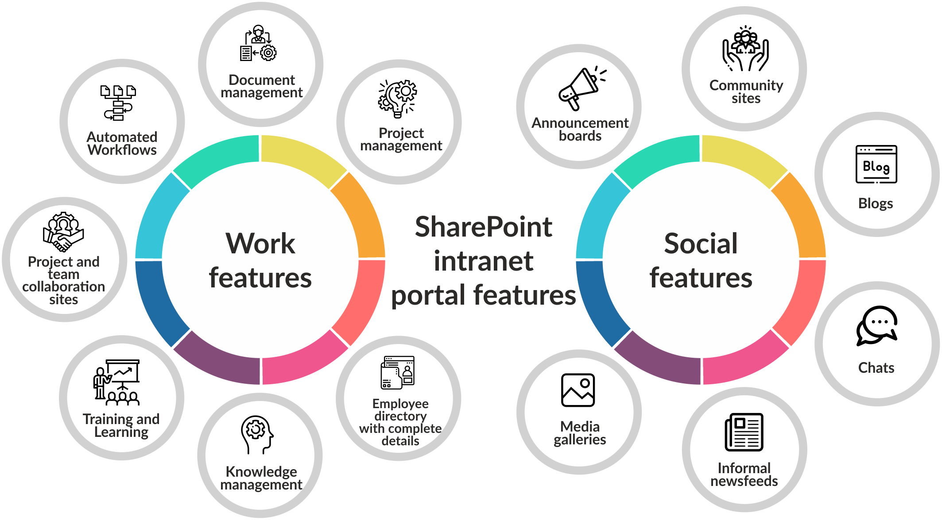
Microsoft SharePoint, Nintex and Power Automate
At Iqra Technology, we enhance business efficiency by integrating SharePoint's robust document management and collaboration tools with Nintex's powerful workflow automation capabilities. This combination streamlines operations, boosts productivity, and drives innovation across organizations.
SharePoint intranet portal features
https://iqratechnology.com/

Slide 11
Microsoft SharePoint, Nintex
At Iqra Technology, we enhance business efficiency by integrating SharePoint's robust document management and collaboration tools with Nintex's powerful workflow automation capabilities. This combination streamlines operations, boosts productivity, and drives innovation across organizations.
https://iqratechnology.com/

Slide 12



Joget ( Low Code Development Platform)
Joget gives companies the ability for nonstop, extensible innovation and development so organizations can adjust rapidly and securely to new priorities of process automation, workflow management and rapid application development in a platform that is simple, flexible, and open.
SIMPLE
Visual, drag and drop.
​Accessible to non-coders.​
​Just a web browser needed, anytime, anywhere.
Our Joget
Services
Joget Development Service
FLEXIBLE
Process driven apps, database centric apps, integration, you name it.
​Build full-fledged enterprise apps.
​Ready for the cloud and mobile.​​​
Joget Support Service
OPEN
Open source.
On-premise, private or public cloud.
​OS, DB, app server independent.
Joget Implementation Service
https://iqratechnology.com/

Slide 13





Oracle Apex
Iqra Technology specializes in providing low code development on the Oracle Apex platform tailored to meet the unique needs of businesses. From developing custom applications to optimizing existing ones, we leverage the power of Oracle Apex to drive efficiency, innovation, and growth for our clients.
Scalability: Grows with user demand and data.
Drag-and-Drop: A user-friendly, visual interface that allows for easy drag-and-drop application development
Security: Protects sensitive data with robust features.
Integration: Seamlessly integrates with Oracle services for efficient data management.
Oracle apex Services
Support Services
Development Services
Consulting Services
https://iqratechnology.com/

Slide 14

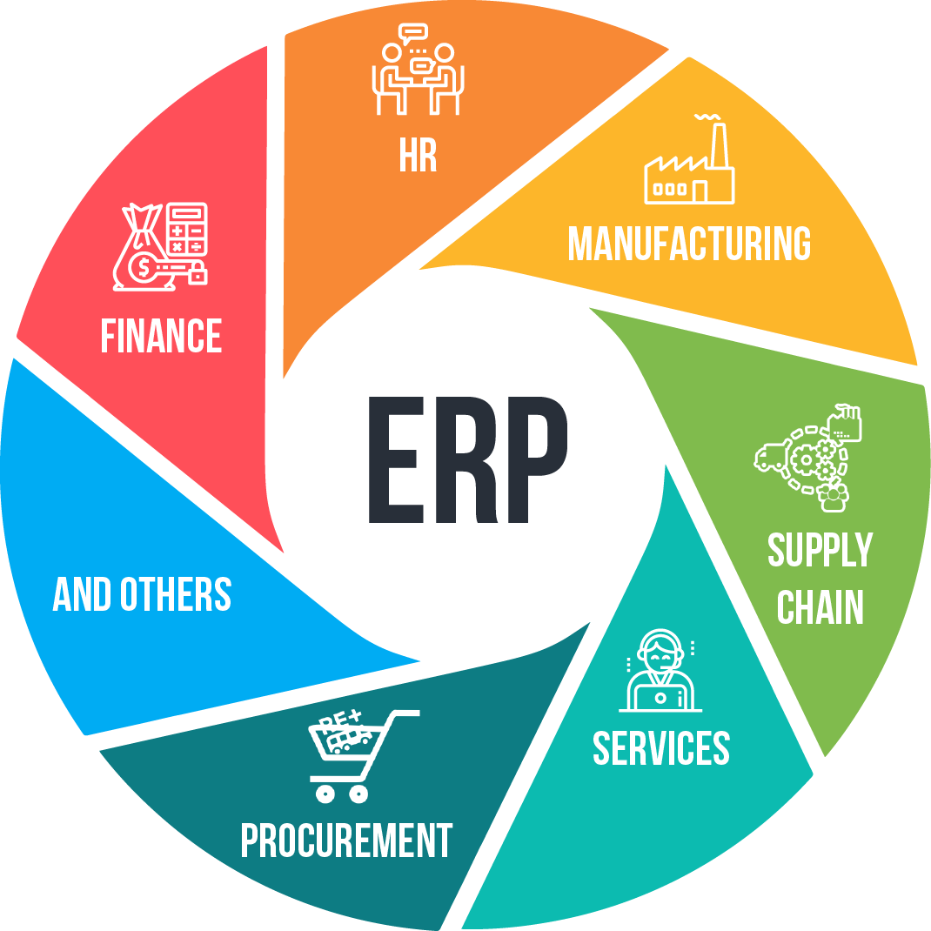
Oracle ERP
Iqra Technology offers a seamless solution with Oracle ERP, empowering businesses with robust tools for streamlined operations, enhanced efficiency, and informed decision-making. With our expertise, we tailor Oracle ERP to fit your unique business needs, ensuring seamless integration and maximum productivity.
Oracle Cloud Application
Oracle eBusiness Suite
Oracle Integration Cloud
Oracle Apex
Managed Services
https://iqratechnology.com/

Slide 15
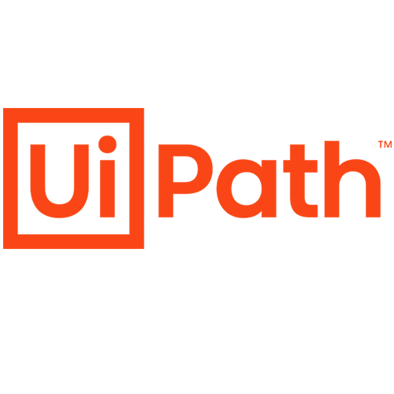

Ui-Path Services
Security, BPM, CRM, ISTM
User-friendly & Speed of Implementation
Machine Learning and Deep Learning
We identify the business process which can be automated and then the time and efforts can be redirected to more productive tasks.
AP Invoice Process Automation
Desktop And Web Automation
CRM Automation
Citrix Automation
ERP Automation
Excel Automation
Screen And Data Scrapping
Email Automation
PDF Automation
.
Based on C#
Programming
Process Mining & Cloud Virtualization
Digital Assistant &
Reusability
https://iqratechnology.com/

Slide 16
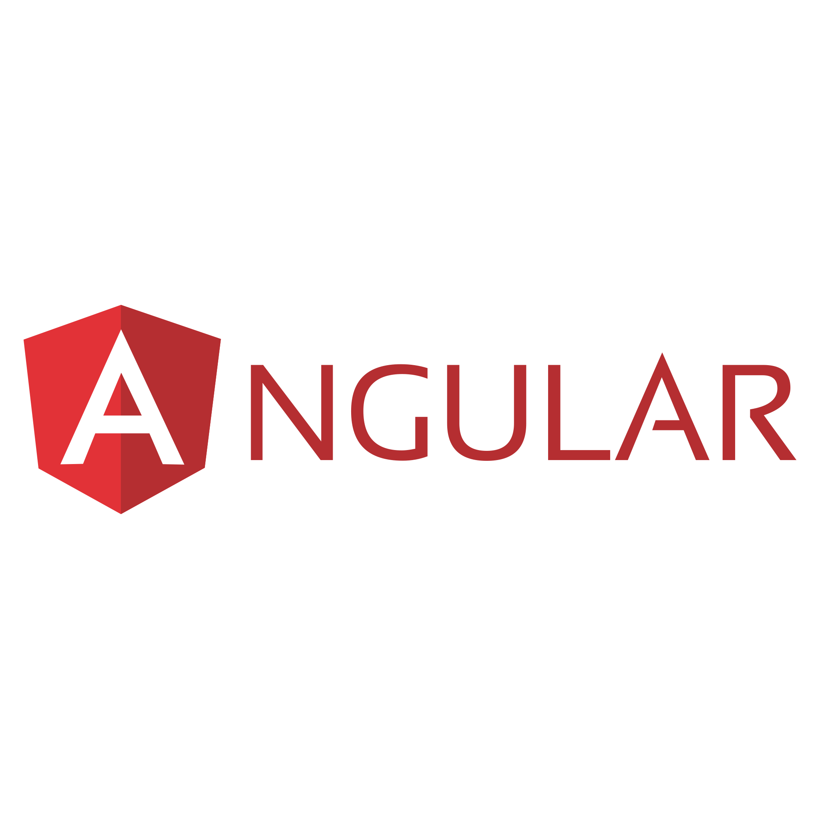

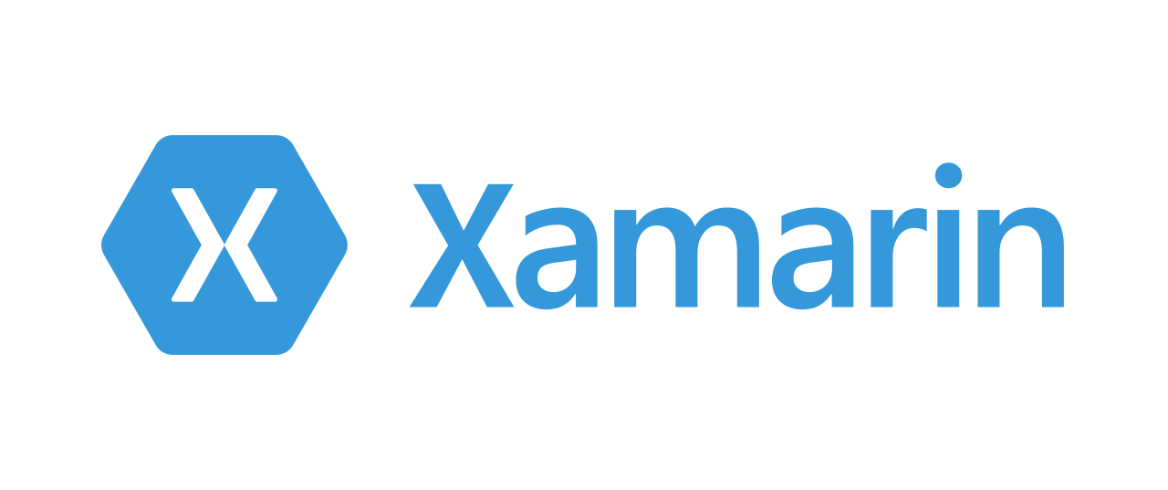




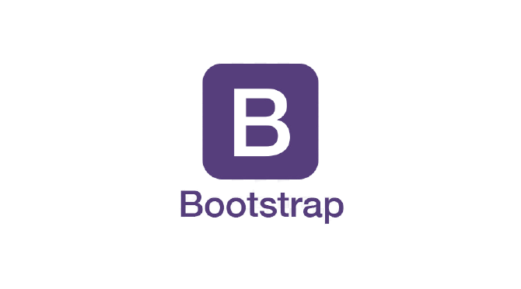



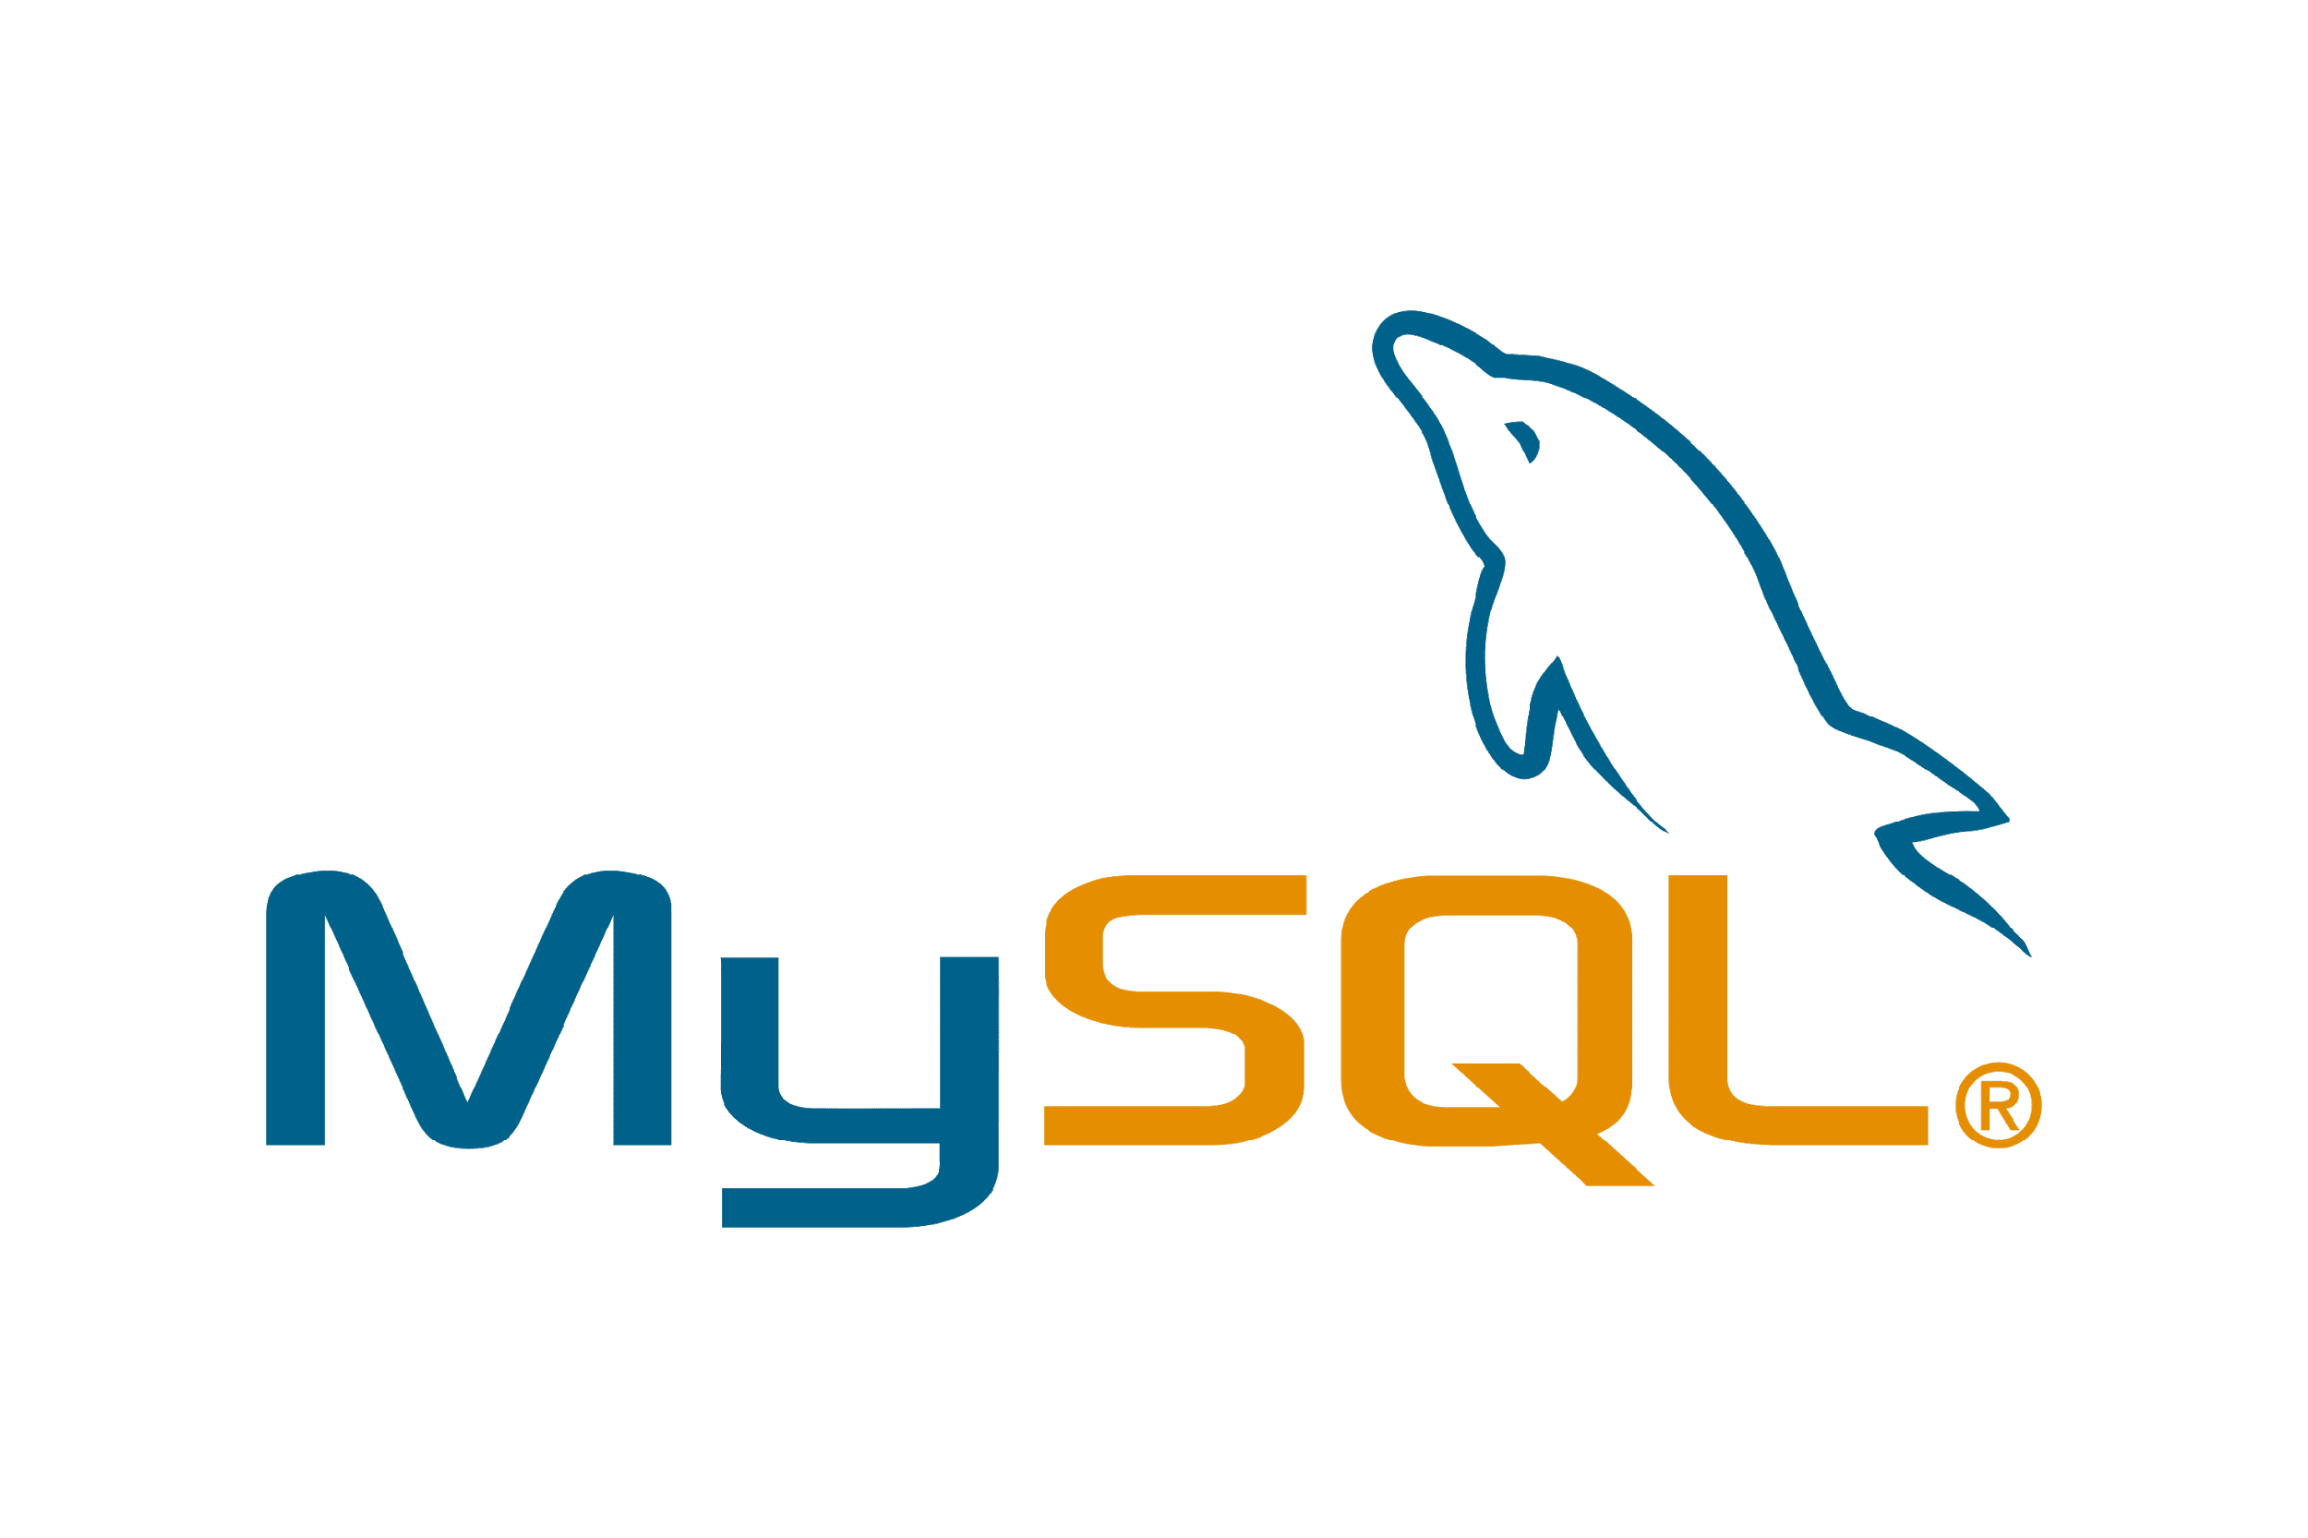



Web & Mobile Technologies
Front End Technology
Mobility
Enterprise Content Management
Back End Technology
Database
https://iqratechnology.com/

Slide 17
Web & Mobile Apps
Customized Application Development
Integration
Support
Requirement Gathering
System Design
User Experience And Interface Development
Business Process & Workflow Development
Testing & Training
Data Migration
Integrate ERP, CRM, Customized Apps
Integrate Website & E-Commerce Solution
Integrate Using Soap API, Rest API, Integration tool, Link Server
Admin services
Report Development
Trouble Shoot Issues
Upgrades
https://iqratechnology.com/

Slide 18



Offshore Resource Model
We provide a Full-time developer to hire & work on your project. Our dedicated developer works as per your official timing.
We provide a part-time developer to hire & work on your project. Our dedicated developer works as per your official timing.
We provide developers on an hourly basis to hire & work on your project. Our dedicated developer works as per your official timing.
Full Time
Part Time
Hourly Basis
https://iqratechnology.com/

Slide 19




Dedicated Offshore Support
We provide Onsite and Offshore support based on your business requirements.
We offer Offshore support in technologies like Salesforce, Microsoft Dynamics CRM, Qlik Sense, SharePoint, Ui-Path, Web Application Development and Mobile Apps Development.
Tailor-made support model as per your requirements.
https://iqratechnology.com/

Slide 20
Dedicated Offshore Support
We provide Onsite and Offshore support based on your business requirements.
We offer Offshore support in technologies like Salesforce, Microsoft Dynamics CRM, Qlik Sense, SharePoint, Ui-Path, Web Application Development and Mobile Apps Development.
Tailor-made support model as per your requirements.
https://iqratechnology.com/

Slide 21





Why Iqra Technology ?
Team of 100+ Skilled Resources
Cost Effective Services
7+ Years of Awesomeness
100% Client Centric Approach
Offshore Software Support Focused Company
System Integrator
https://iqratechnology.com/

Slide 22






Industry Expertise
Retail
Manufacturing
Energy
Supply Chain Distribution
Service
Hi-Tech
Trading
Real Estate
https://iqratechnology.com/

Slide 23































Some of Our Clients
https://iqratechnology.com/

Slide 24
THANK YOU
Your Business Solution Partner

